Slide 1
Big Data Visualization
Nakul Bajaj

Slide 2

About Me
https://www.linkedin.com/in/nakul-bajaj-707b7649/
University
Masters of Business Information Systems (2015-2017)
Business Analytics Specialisation
Business
Family Business 2 Years
Employment Experience
~ 2 Years 8 Months ANZ
11 Months YellowfinBi
Data Visualisation Experience
IBM Watson Datathon
Data Science Tool Box
Business Apps and Insights for clients

Slide 3


History on Data Visualisation
Prior to the 17th century, data visualization existed mainly in the realm of maps, displaying land markers, cities, roads, and resources.
Symbols and drawings in caves about hunts, fire, etc.
Charles Minard’s 1869 showing Napoleon’s 1812 infamous Russian campaign army

Slide 4
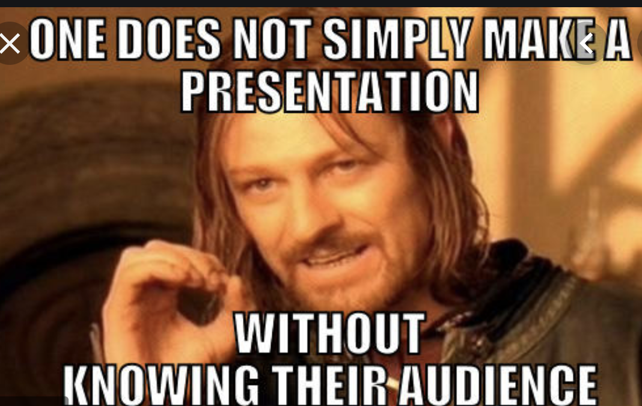
Who is the audience?
Myki Dataset – Council, Commuters, Vic Government
Data Analyst or CEO

Slide 5
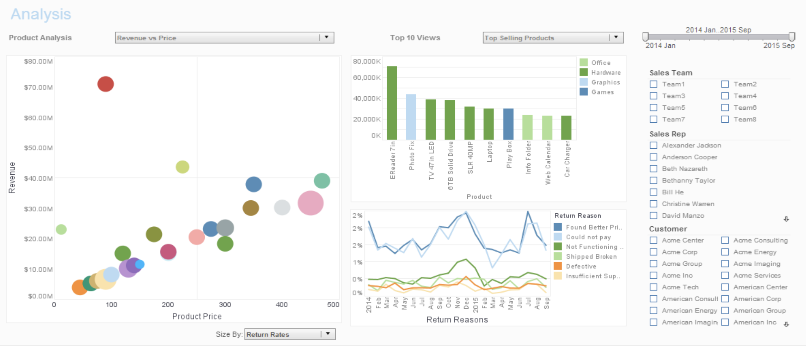
Types of Dashboards (Analytical Dashboards)
(What → How → Why)
Exploratory Analysis
Drill down functionality
Filters

Slide 6
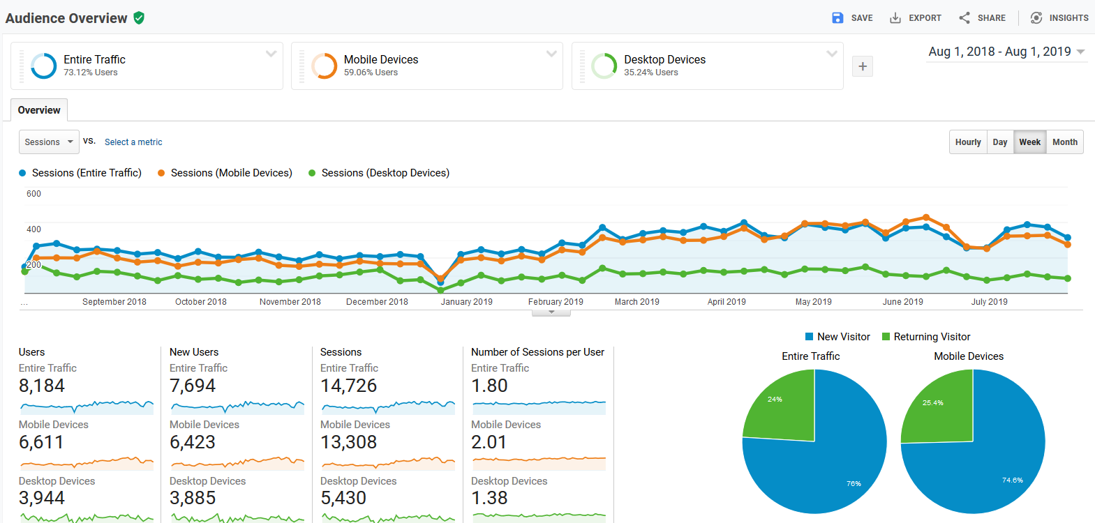
Operational Dashboards (What--> Maybe Why)
Monitoring
Metric checks

Slide 7
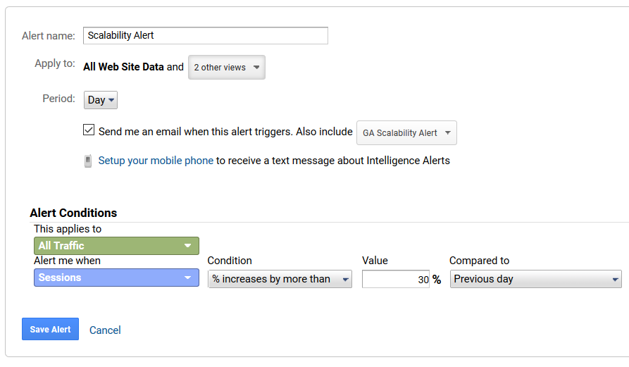
Operational Dashboards
Alerts

Slide 8
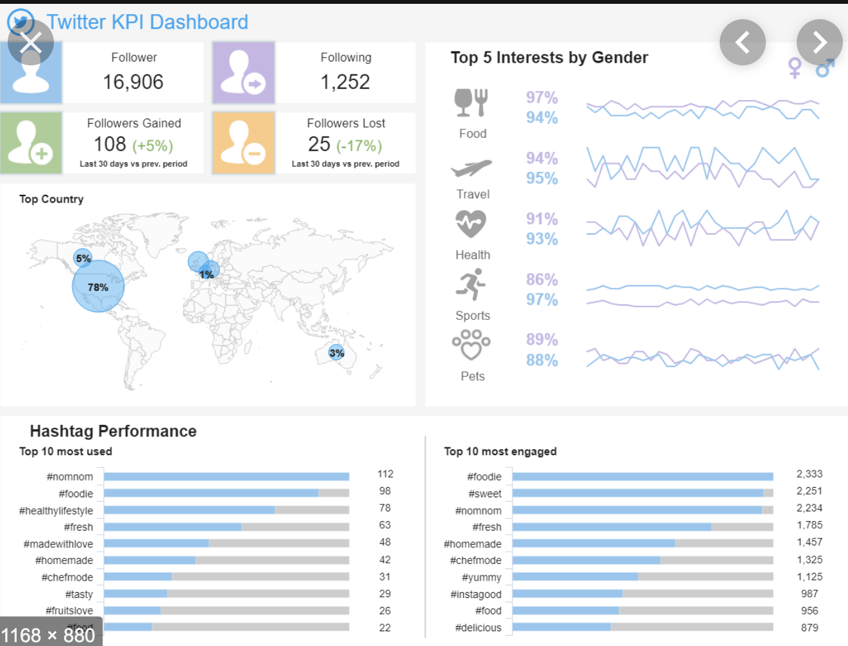
Business Strategic Dashboards
Business/Strategic Dashboards (What → Why → So What)
Actionable Insights
Strategic Metrics
Signals (Significant change, with action associated)
20% increase in customer spending, in comparison to last three months, so I should think of opening a new store in Ballarat

Slide 9
Infographics

Slide 10
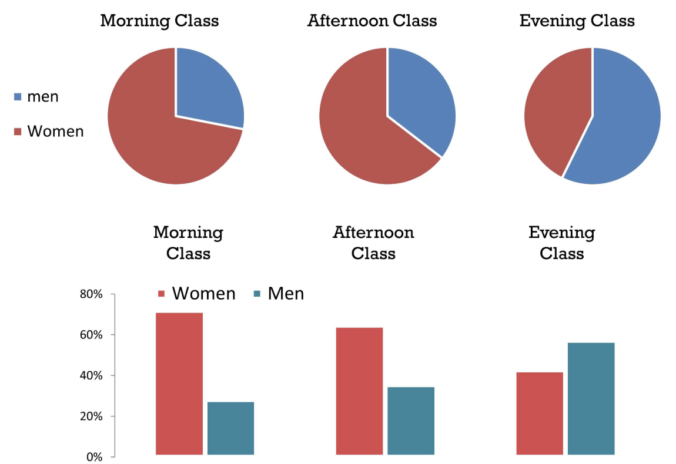
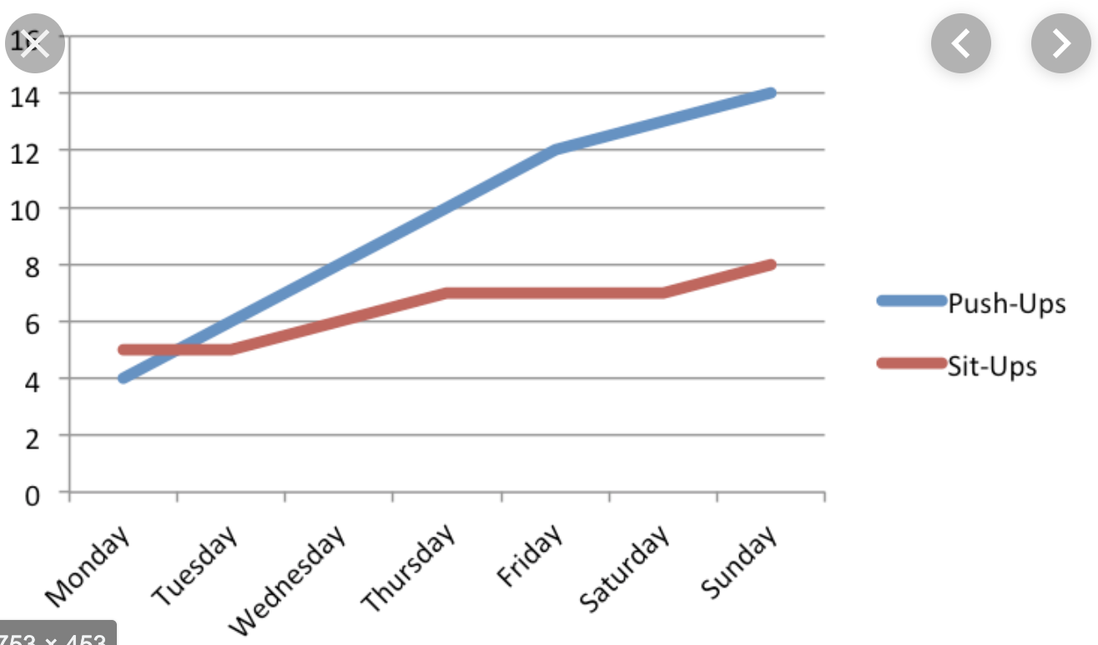
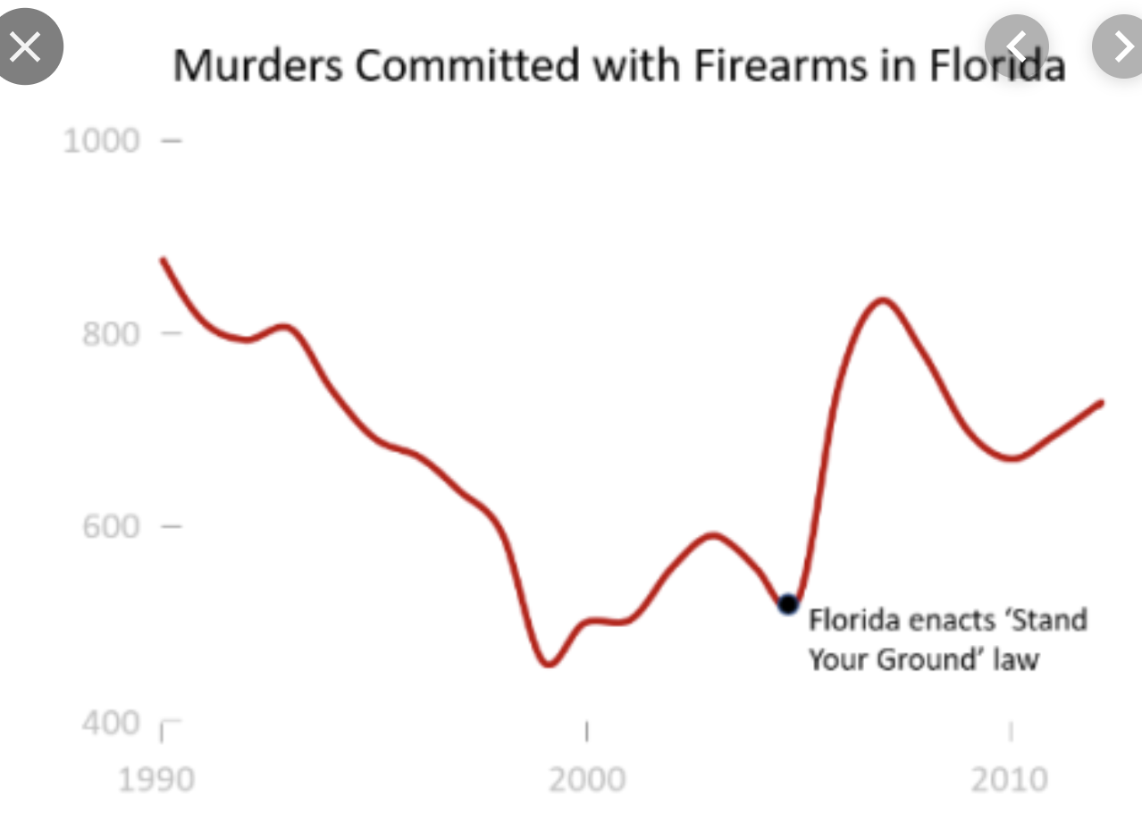
What makes a good data visualisation
Simple
To the point
Less cluttered
https://infovis-wiki.net/wiki/Data-Ink_Ratio

Slide 11
Colours in Data Visualisation
Nearly 8% males and 0.4% females according to Australian Eye Institute (Australia’s largest private provider of ophthalmic services)
http://colorbrewer2.org/#type=sequential&scheme=BuGn&n=9
Colour palettes
Random (No order to your data)
Categorial Data
Sequential
Low to High. High is very important
Diverging
Low and High are important

Slide 12
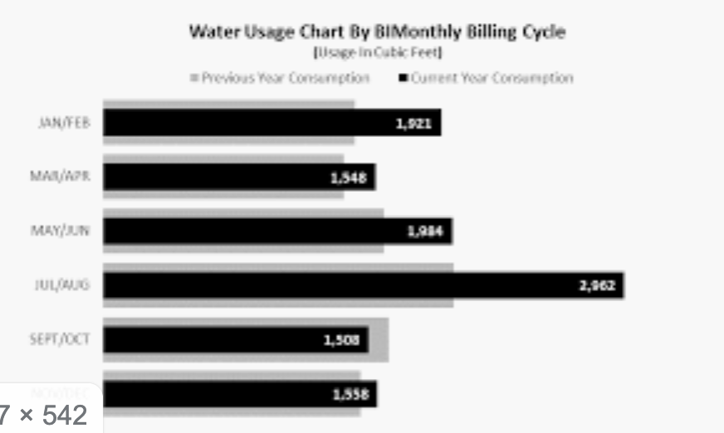
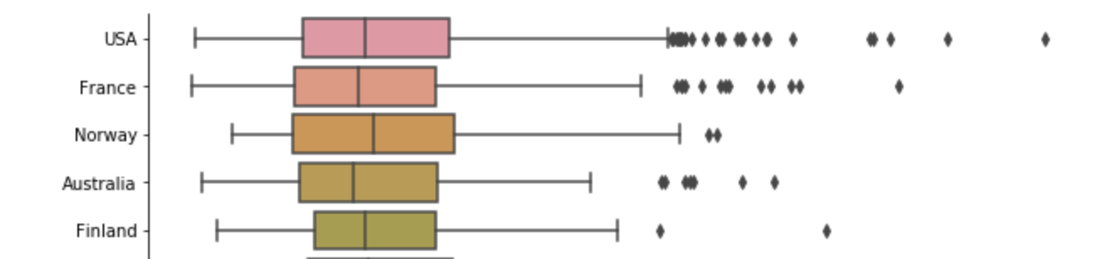
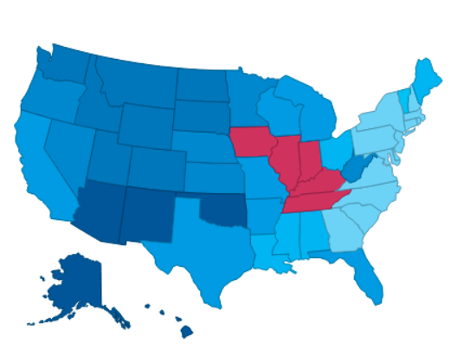
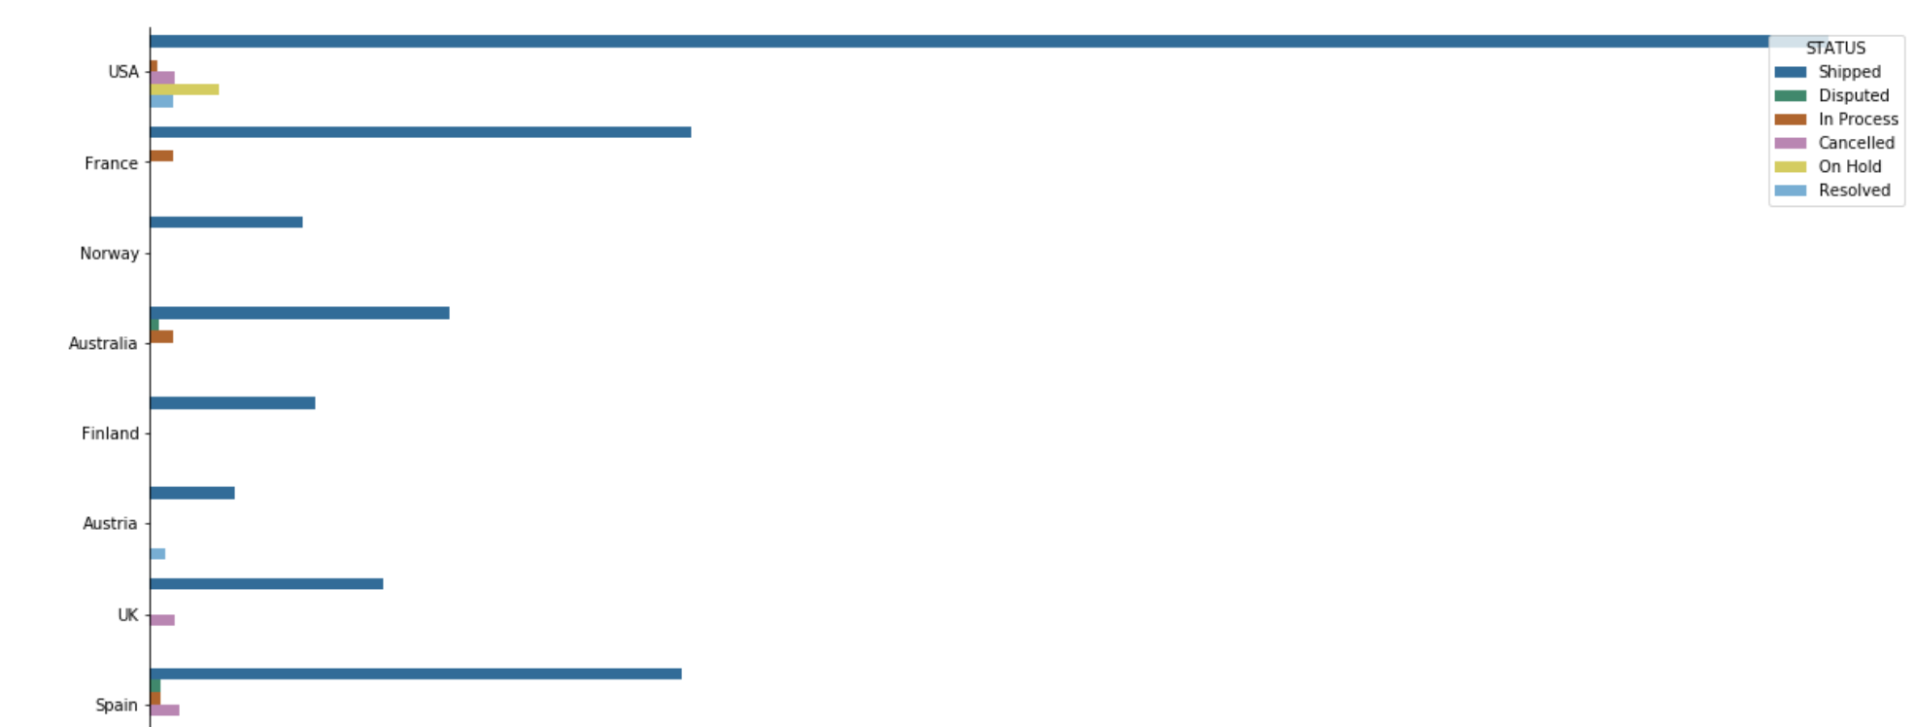
Plot Types
Categorical Data: Geographical, ethnicity, student/non-student. Accompanied by a numerical value
Bar Charts – Basic, Grouped, Stacked, Bullet
Box Plots
Maps

Slide 13
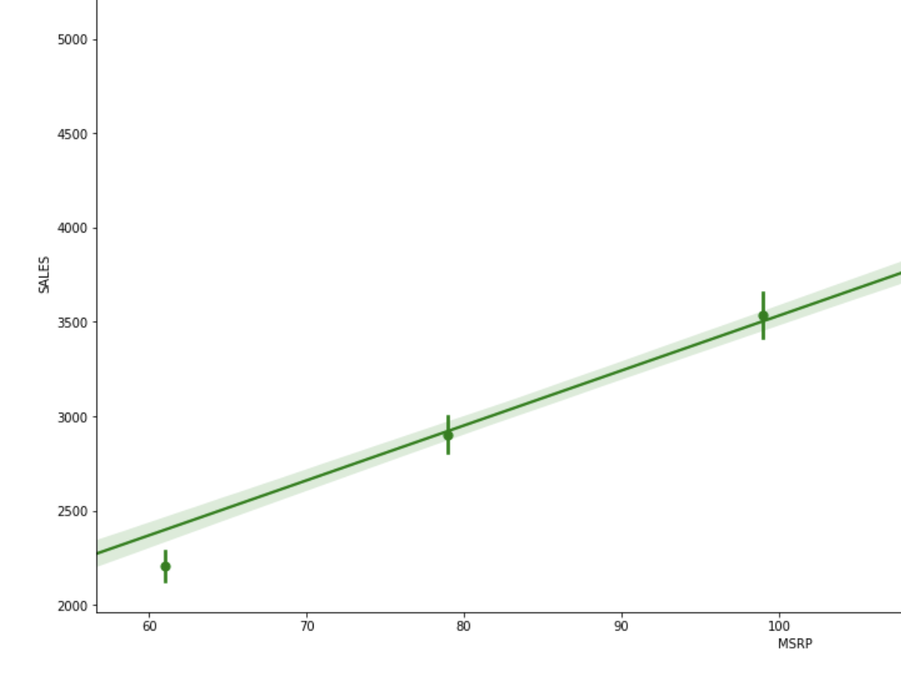
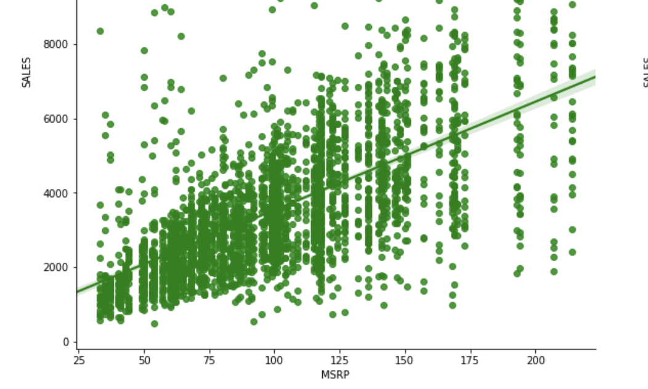
Plot Types 2 – Regression Plots

Slide 14
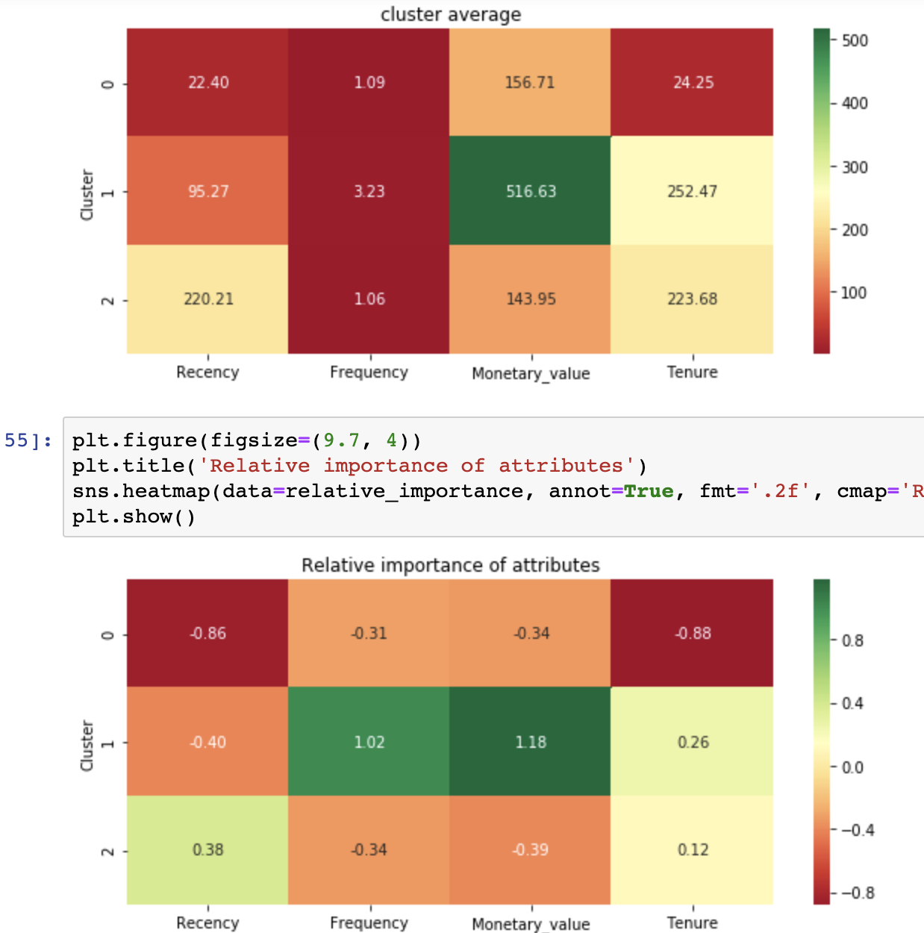
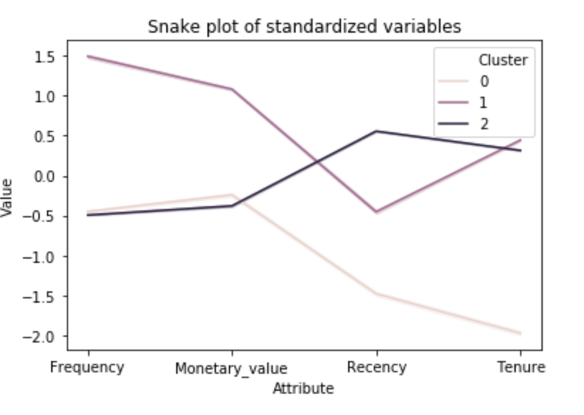
Advanced Plots
Heatmap
Snake Plot

Slide 15
Approaching a data visualisation in business
Go end to end with visualisation within a week/two
Ideally start with a piece or paper or white board (Maximum 1 day effort)
Validate with the user
Get feedback
Aesthetics
Business value
Data Quality
Bias
Iterate over next week or two
Repeat 2 and 3 (5-10 times)
5-10 times means get 5-10 users feedback or product owner feedback over 5)
Approach described is agile framework. Focuses on quick deliverables maintain quality and within time and budget.

Slide 16
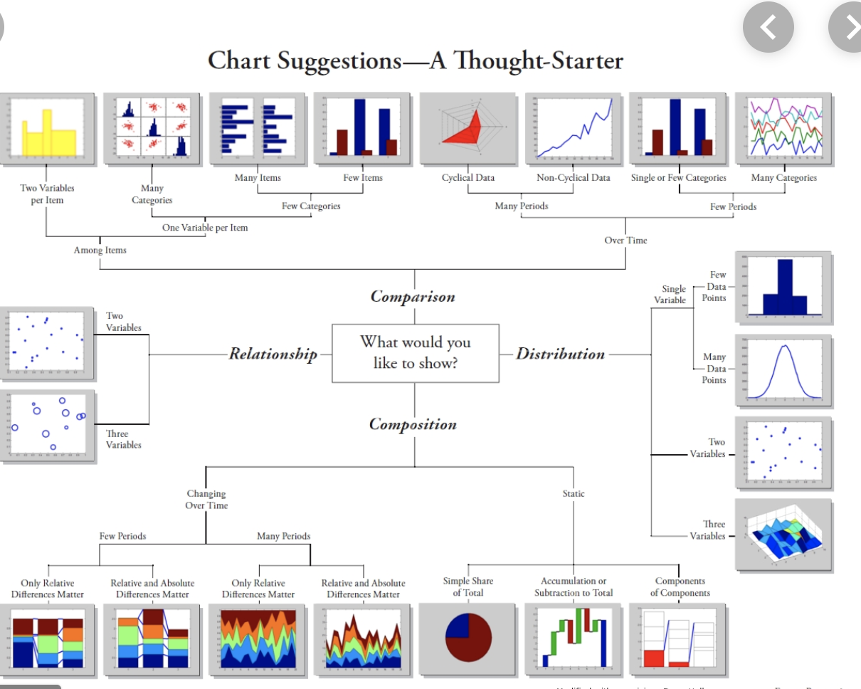
Thank You

